Slide 1
SSH using Linux or Mac

Slide 2
SSH and Prerequisite
Allows us to control a remote machine using
terminal or command line.
If an EC2 instance will be created with us then only we will be able to SSH into it.

Slide 3
SSH and Prerequisite
SSH Key the file will be in the “.pem ” form.
EC2 Instance and the last thing which we will need is a username.

Slide 4
SSH and Prerequisite
We will have public IP as well as DNS with which we will be able to connect to our instance.
We will go ahead and copy our Public IP address because we will be requiring it in the coming steps.

Slide 5
SSH in Mac
Open the terminal.
On the Mac, we need to
Click the Launchpad icon in Dock.

Slide 6
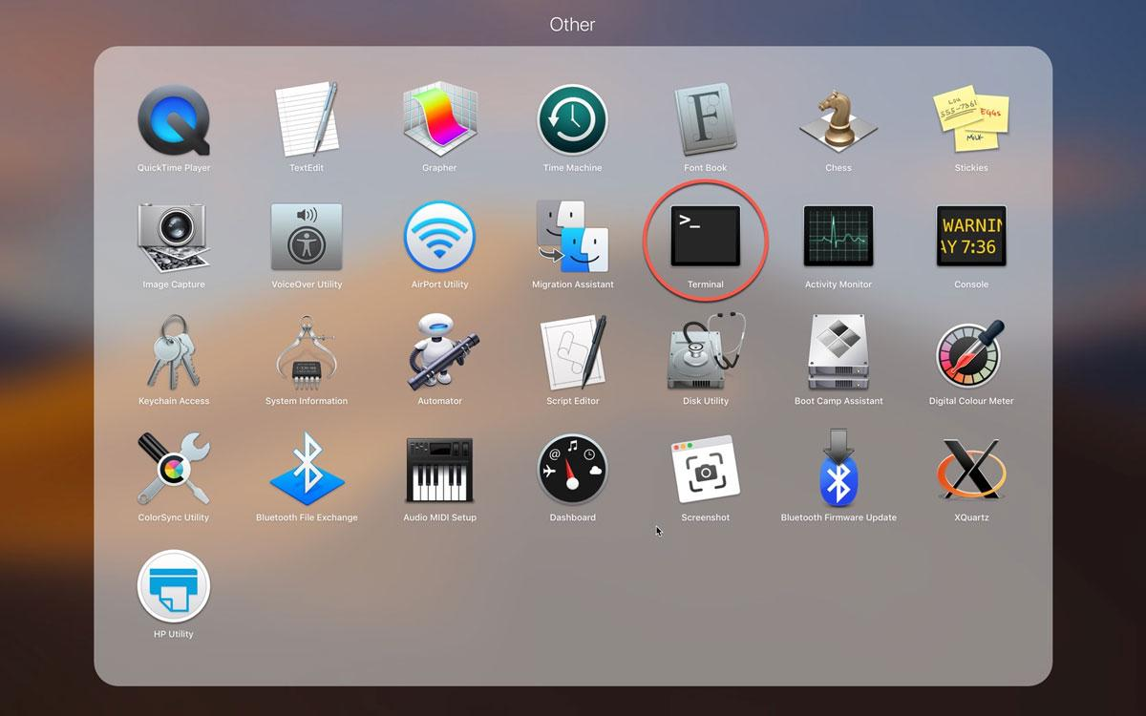
“This is a quote, words full of wisdom that someone important said and can make the reader get inspired.”
—Someone Famous
Icon of terminal

Slide 7
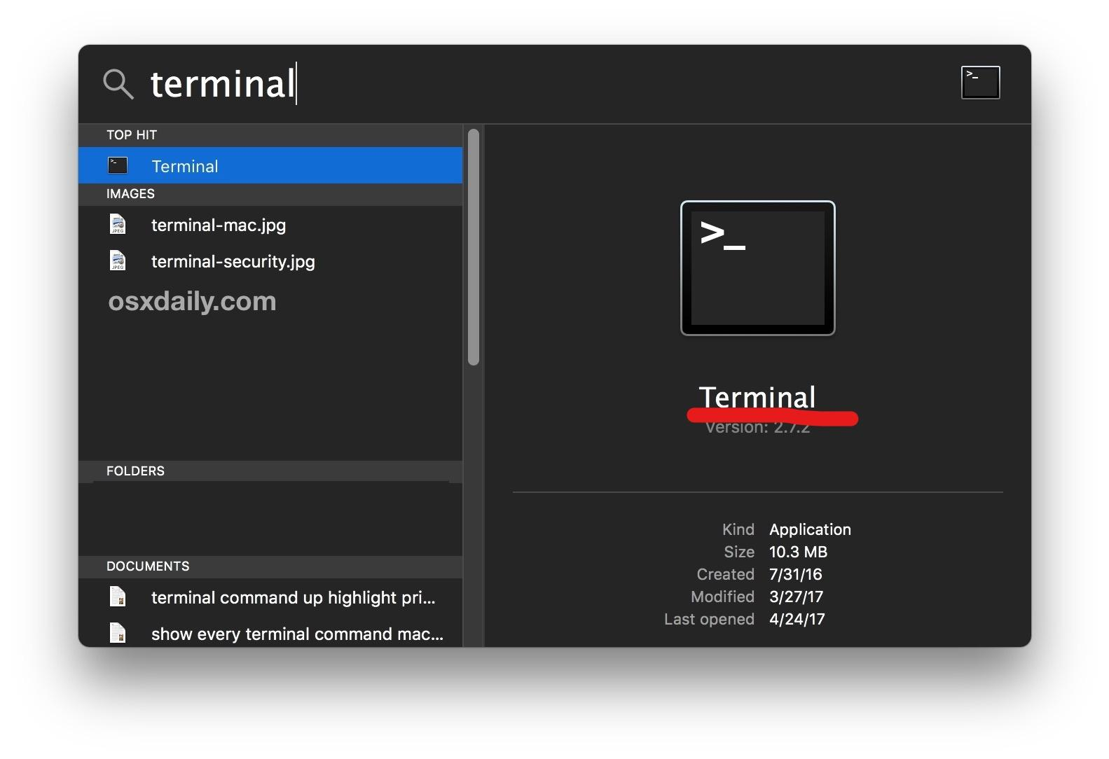

Slide 8
SSH in Mac
SSH into the terminal
Type a command
“ ssh ec2-user@(IP address)”
Type “yes”.

Slide 9
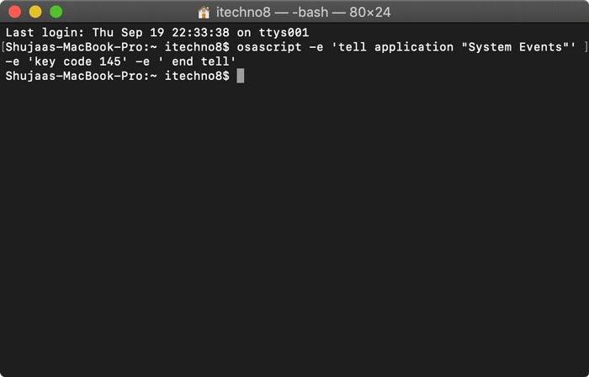
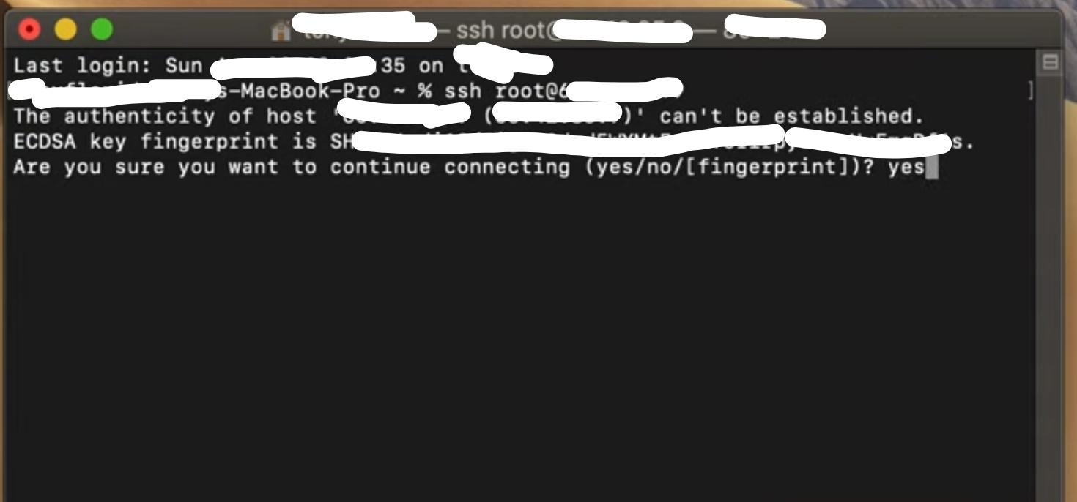

Slide 10
SSH in Mac
use key which we have downloaded.
“The first instance.pem”.
Add the same key-id into the command.
“ ssh –i first instance.pem ec2-user@(IP address)”

Slide 11
SSH in Mac
Warning which will be like that the key file you are trying to use is unprotected.
Our private key they will easily SSH into it.
Fix this issue is “chmod 0400 and then key name” (here key name is the first instance.pem).

Slide 12
SSH in Mac
Run the same command which is
“ ssh –i first instance.pem ec2-user@(IP address)”.
Click enter and SSH into the console and here we can read Amazon Linux 2 AMI.

Slide 13
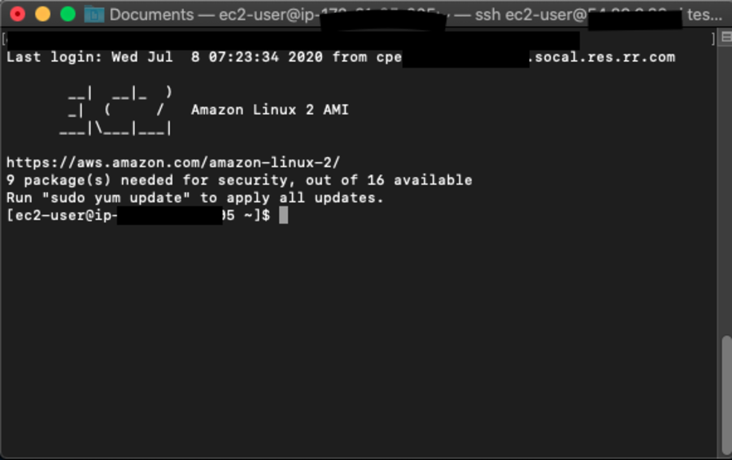

Slide 14
SSH in Mac
Create a file simply by entering the command “touch filename” or it can be deleted by entering the command
“rm filename”.
Exit the instance by entering the command “exit followed by an enter”.

